Slide 1



SWIFTSPOT
Made by
Khalil Samara
Ibrahim Abu Laban
Omar Obeid

Slide 2
SCENARIO
A tenant lives somewhere around PSUT & has a garage available from 9 AM to 5 PM
A PSUT student books the tenant’s parking & arrives on time to park
The tenant makes extra money on the side while Swift Spot takes a dividend
The student saves time & hassle by getting a convenient parking space in the location they prefer
Everyone wins

Slide 3

AREAS TO TARGET
Almost all of Amman has parking difficulties, but based on our research these areas need parking improvement the most:
Civil Status & Passports Department -Tabarbour
Ministry of Interior & around it - Dakliyah Circle
Shmesani
Downtown
Mecca Street

Slide 4

SCOPE STATEMENT
Login & Sign Up should be available for all users
Search & Filter features for the user
Parking history can be accessed by the user
User should be able to add & edit payment methods
User should be able to request to become a Parking Provider from the Admin
Parking Provider should be able to request a parking addition from the Admin
Approve/Reject parking provider request by admin

Slide 5
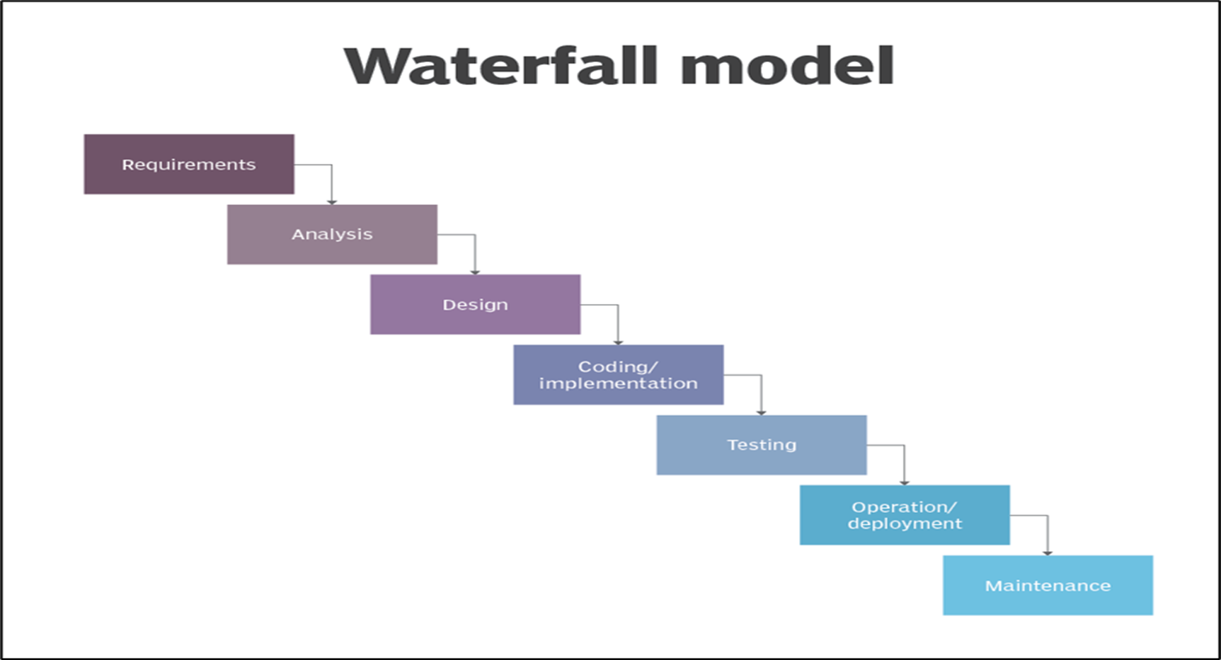
SOFTWARE DEVELOPMENT LIFE CYCLE
WATERFALL MODEL

Slide 6
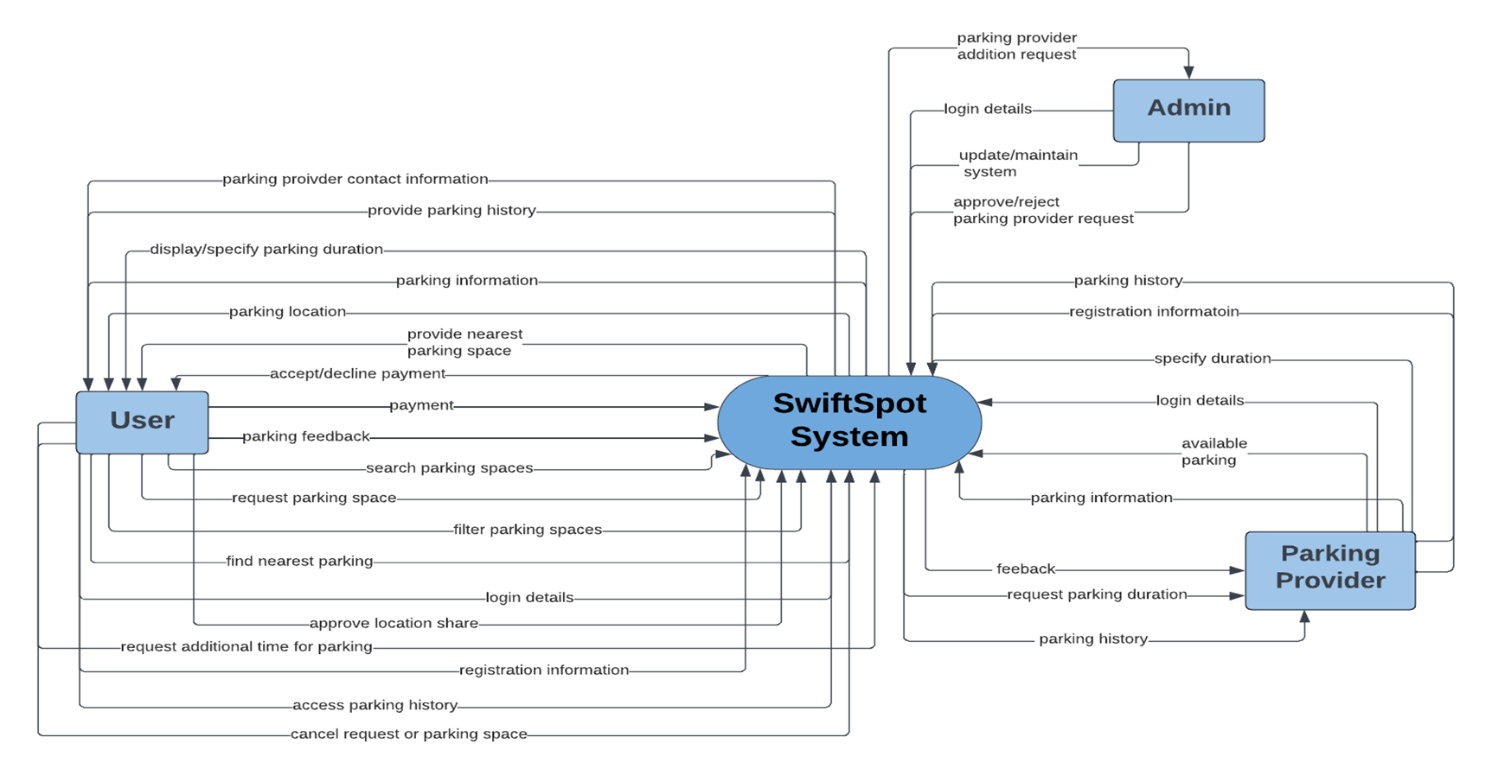
CONTEXT DIAGRAM

Slide 7
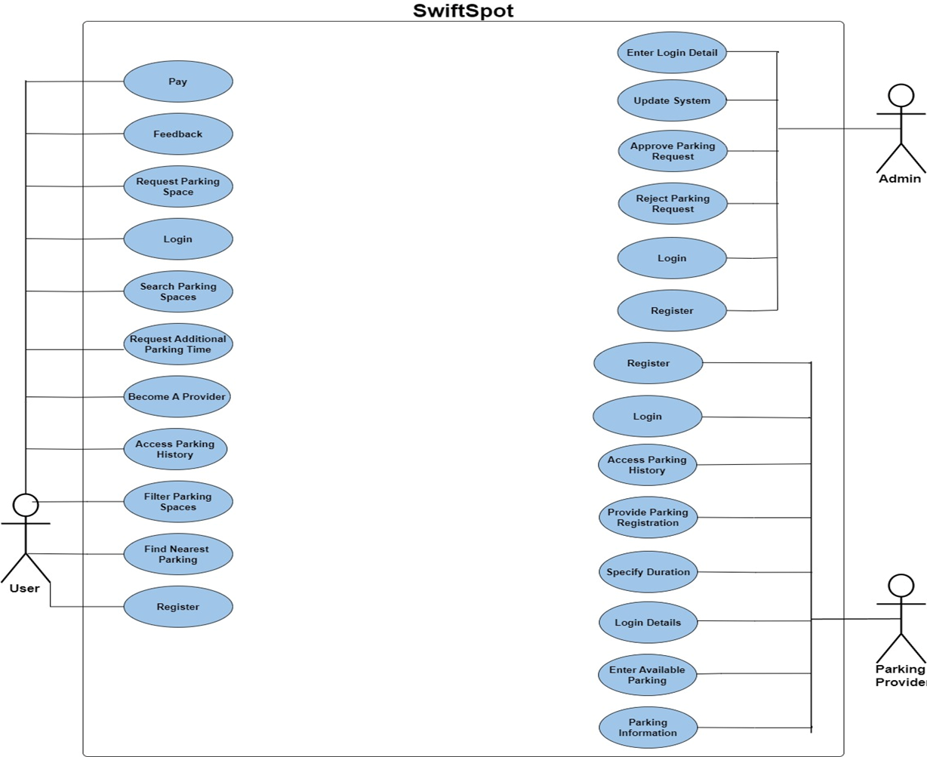
USE CASE DIAGRAM

Slide 8
REQUIREMENTS
FR-01 The system shall have a splash screen with the logo displayed.
FR-02 The system shall have an onboarding screen with three distinct instructions.
FR-03 The user shall be able to log into the system using their email and password.
FR-04 The user shall be able to register a new account.
FR-04.1 The system shall allow the user to register by entering their email, name, password, and mobile number.
FR-04.2 The system shall authenticate newly registered users using OTP through the given phone number.
FR-04.3 The system shall ask for the user’s permission to access their current location or to set their location manually.
FR-04.4 The system shall ask the user to choose the language.

Slide 9

RISK MANAGEMENT PLAN
2
4
Risk Analysis
Risk Response Actions
1
3
5
Risk Identification
Risk Priority
Risk Response Strategy

Slide 10
SOFTWARE TESTING
Due to the importance of software testing, five different testing techniques were applied, these were:
White Box
Black Box
Ad Hoc
Performance
Security

Slide 11

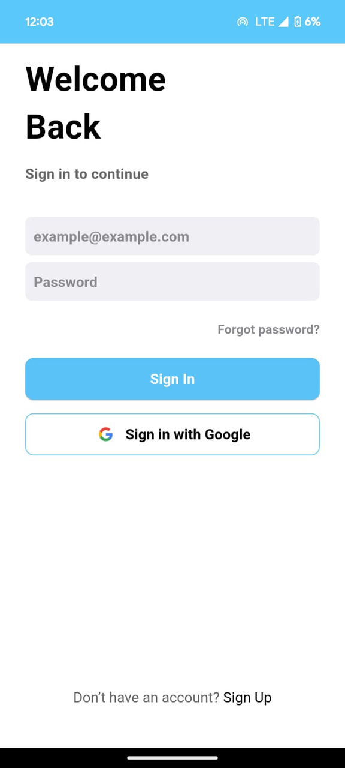
BLACK BOX TESTING EXAMPLE
SIGN IN SCREEN
Test Case Description: Verify that login is successful with valid credentials.
Test Precondition: User must be registered (signed up) to the Application.
Test Steps:
Access the sign in screen.
Enter email and password.
Click on the sign in button provided.
Test Data 3:
Email: omarobeid136@gmail.com
Password: 1111111
Test Result: Asks for valid password.

Slide 12
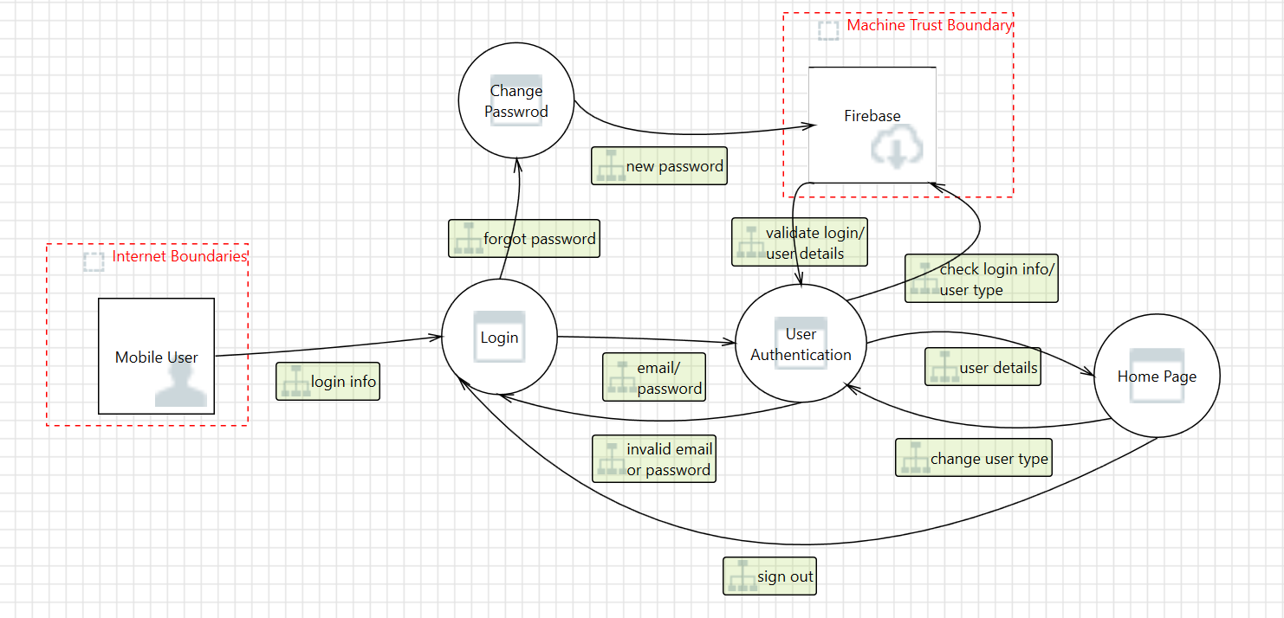
SECURITY
TESTING
MICROSOFT THREAT
MODELING TOOL

Slide 13

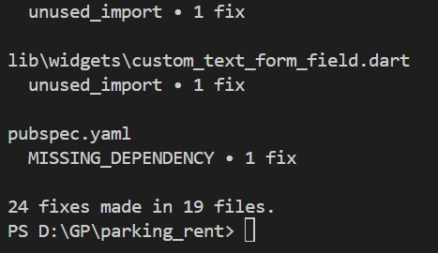
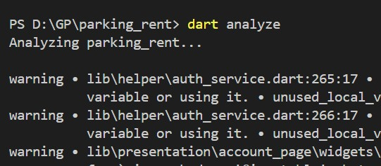
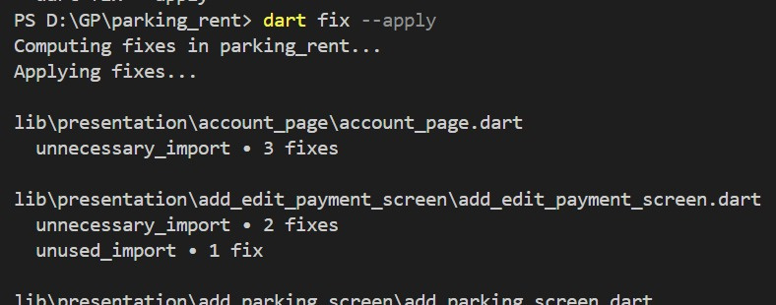
WHITE BOX TESTING
3
DART SDK TOOLS
Native Dart SDK tools were also used, which tested errors, style, & pub rules.
It also offered automatic fixes which were applied
1
2

Slide 14


MOVING ON TO THE DEMO

